Slide 1
Fish Freshness Classifier

Slide 2
Singapore Fresh Fish Market
Problem Statement & Solution
Exploratory Data Analysis
YOLO Working Principles
Model Results
Demo
Future work

Slide 3
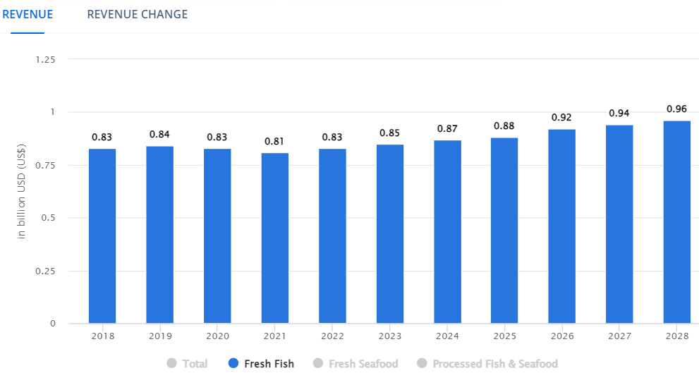
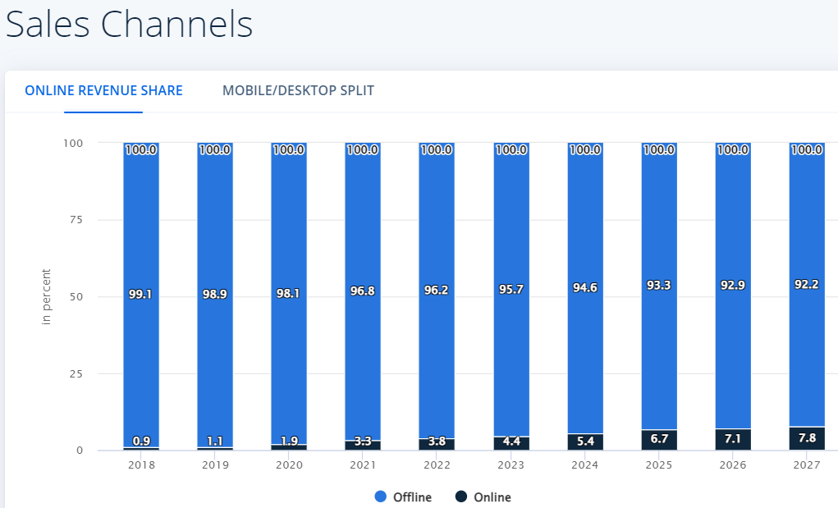
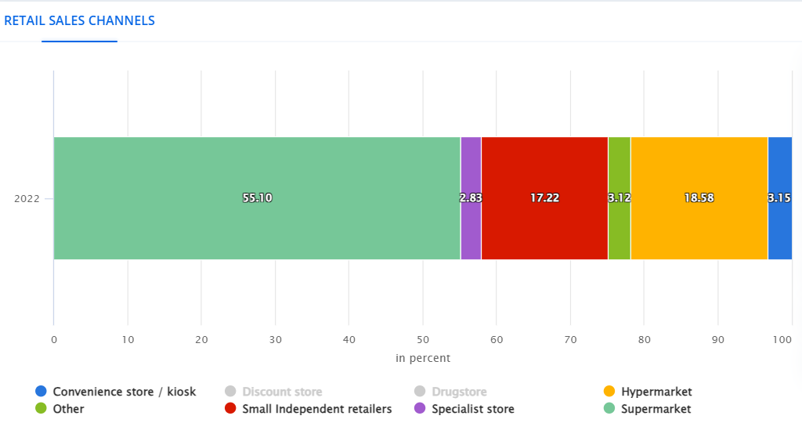
Brief Insights on SG’s Fresh Fish Sales
SG Revenue for Fresh fish
Sales Channels
Retail Sales Channels
Notes:
Singapore’s current fish market is worth $850 million USD
This is expected to grow at a compounded annual growth rate of 2.5% to 960 million in 2028.
But if you take a look at the sales channel, only 4.4% of it is sold online and the remaining is sold through brick and motar shops and 75% of this offline sales are from super and hyper markets, such as our wet markets, Sheng Siong, NTUC, Giant and Prime

Slide 4
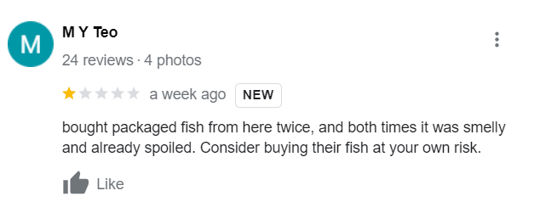
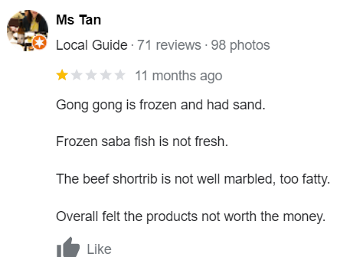
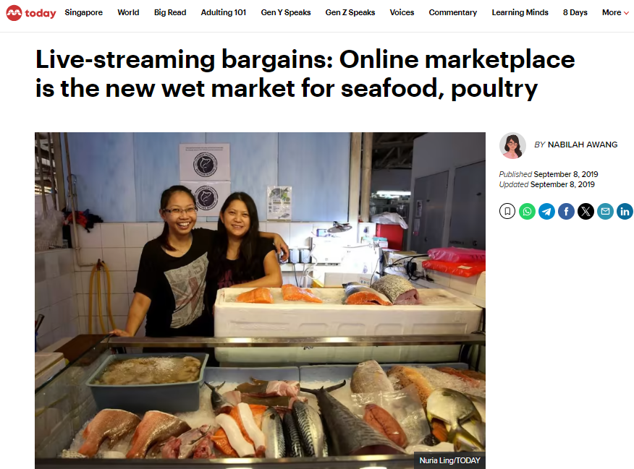
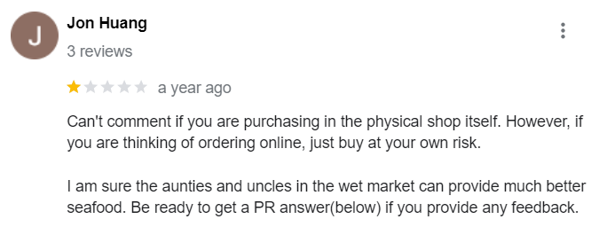
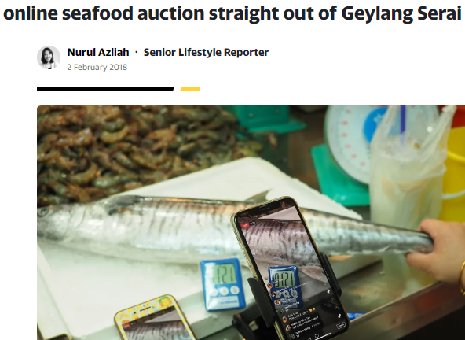
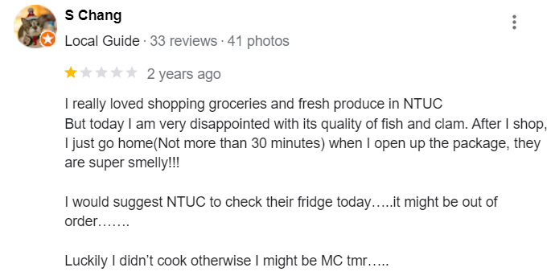
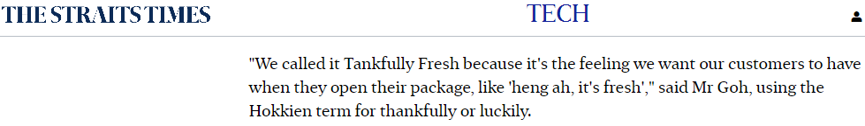

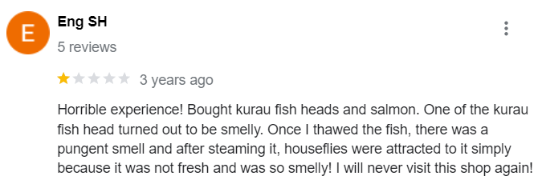
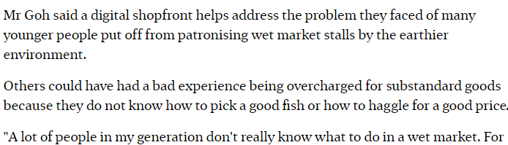
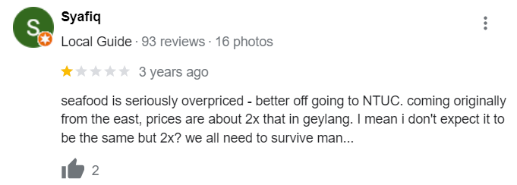
Online Sales & Issues with Fresh fish sales
Bad experiences from non fresh fish sales
Innovations for online sales
Notes:
This is a picture indicating how people are using technology to boost their sells online through live auction. But how sure are we that the fish being sold and delivered is the same fresh fish?
This is a straits times article about tankfullyfresh. A popular online fish delivery company.
This extracts shows how thankfully fresh got its name. It goes to show how important it is for consumers to receive fresh fish.
The Founder of thankfully fresh also goes on to mention that the younger generation do not like to go to the wet market, and if they do not know what to do in a wet market and they could be over charged if they do not know how to pick a good fish
These are some online reviews that supports tankfully fresh founders statements about people being overcharged and buying non fresh fish from shengsiong, ntuc and online delivery companies.

Slide 5
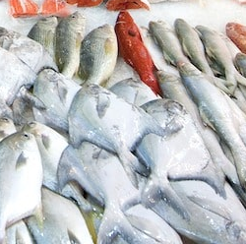
Problem Statement & Solution
How can we improve consumer confidence for online deliveries to ensure that the customer that buys fish online receives a fresh fish?
How can we empower consumers with the necessary bargaining power by helping them determine whether a fish is fresh or not,
How can offline and online businesses gain a competitive advantage by assuring customers that the fish they are selling is indeed fresh?
Solution:
A computer vision application that informs how long a fish had been out from the sea using the image of the fish.
Potential Deployment/Use Cases
Model could be hosted as an app on Mobile devices
Model could be deployed in supermarkets, wet market and live auctions on a display like device
Successes Factors:
Model should work in real world environment with an
MAP of > = 85%
Day - 0
Day - 1
Day - 2
Abv Day 2
Notes:
So How can we improve consumer confidence for online deliveries to ensure that the customer that buy’s fish online receives a fresh fish?
How can we empower consumers to determine whether a fish is fresh or not, and provide them with the necessary bargaining power if the fish is not very fresh
How can both offline and online businesses assure customers that the fish they are selling is indeed fresh?
My Solution:
A Model that can tell how long a fish had been out from sea by scanning the fish with a camera
This device could be an app that consumers can downloaded in their handphones so that when consumer buy their fish from the brick and mortar stalls, they can determine how old the fish is and whether to buy, bargain or not buy at all.
It can also be used to scan the fish straightaway when they receive it from delivery companies.
Or the device could also be available on screen like display in the supermarkets, wet markets and live auctions website to improve customer confidence and give themselves a competitive advantage
The success factors for this model is that it should be able to work in a real world environment with a Mean average precision of at least 85%

Slide 6
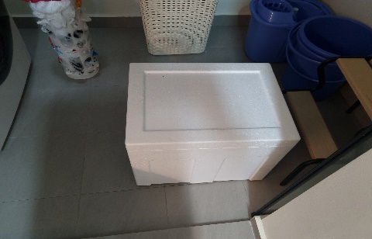
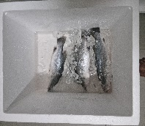
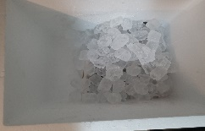
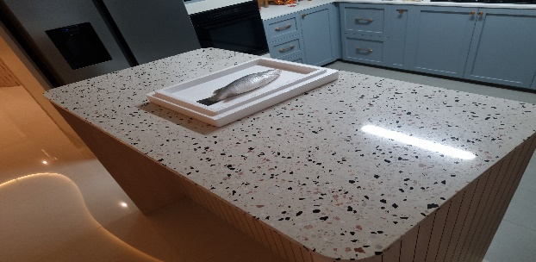




Approach
48 photos captured daily from day 0 – 7
Fish was kept in Styrofoam box and topped-up with fresh ice daily to replicate wet-market conditions
Day 0.…Day 3
Abv Day 3
Data Collection
Data Augmentations
Annotations
Training
Deployment
Augmentation was only applied to day 0-3
Only flip and rotation was applied so as not to alter the colour or dimensions of the actual image
621 images after augmentations
Notes:
In order to collect data I bought three seabass from sheng Siong, and started taking photos from Day 0 to Day 7.
Each fish was photographed from 8 angles each side. So I would minimally capture around 48 photos per day
To simulate actual market conditions, the fish was kept in a Styrofoam box through the 7 days. Each day the melted ice was drained and topped up with fresh ice.
I captured around 300+ images. These images were then augmented using the albumentations library. I only applied the augmentations to day 0-3, as I wanted to label day 4 -7 as above day 3. Only flip, and rotations transformation were applied to the images so as not to alter the resolution, dimensions and colours.
The images were then annotated using roboflow as Day 0, Day 1, Day 2, Day 3. Days 4-7 were categorised as Abv_Day-3.
After annotations the pictures and t annotations were fed into yolo for for training. Then finally steam lit application was built to deploy and demo the model.

Slide 7
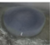
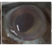
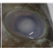
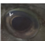
Gauging freshness from the Eyes of the Fish
Day 1
Day 0
Day 5
Day 1
From Day 0-7, guess how old the fish are from its eyes.
Notes:
From the pictures of the fish eyes Guess how many days has it been since the had been out from the sea.
So main take away from here is that the rate of deterioration can vary across different fish, making it challenging for us to identify a fresh fish.

Slide 8
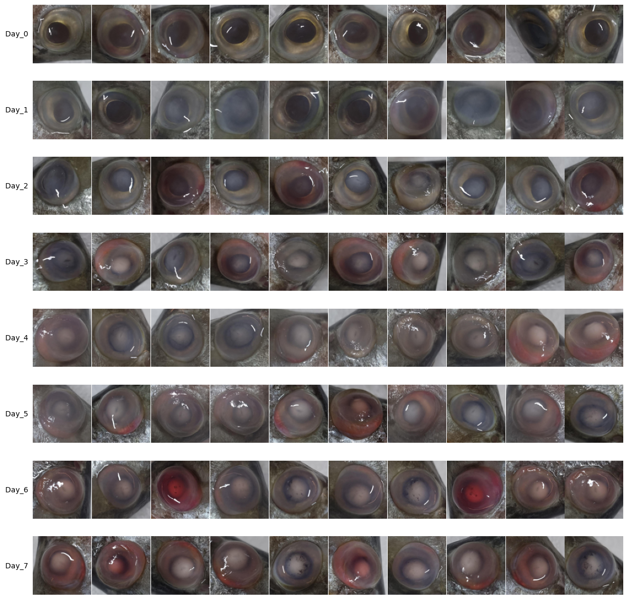
EDA – Fish Eyes
Most Fresh
Bright and back eyes with golden perimeter
Eyes begin to fog
Eyes turn white and dry
Eyes become pinkish
Least Fresh
Photos from previous slide
Notes:
So these are 10 randomly selected cropped photos from each day.
When they are very fresh the fish usually has bright and black eyes with a golden permitter
Then it becomes Eyes become foggy
The Eyes start to become white and dry
Then the Eyes become pinkish red
But I would like to reiterate that the rate of these symptoms can vary across different fish. Like the yellows which are the pictures used in the previous slides

Slide 9
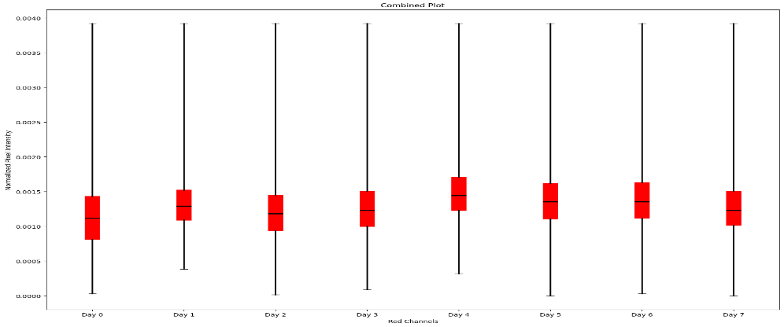
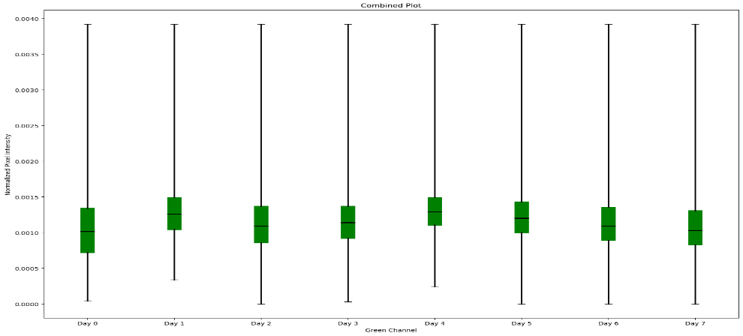
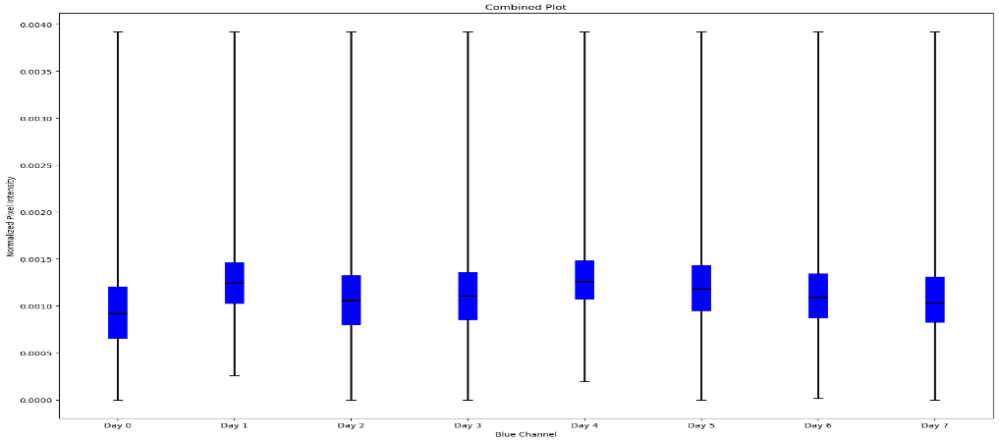
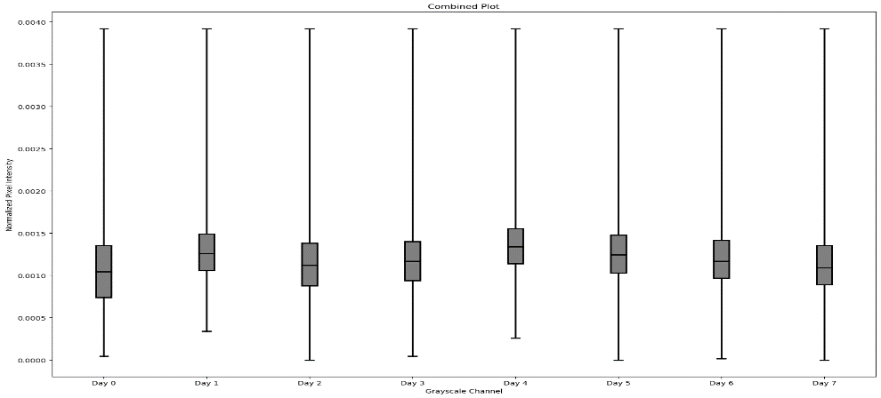
EDA – Normalised Colour Channels
Red Channel
Green Channel
Blue Channel
Grey Scale
Day 0
Day 7
Notice any significant pattern from the colour channels?
Notes:
An image has three colour channels, red, green and blue. The image can also be converted to grey scale. A lower pixel value in the grey scale image corresponds to black and the highest pixel value corresponds to white.
This slide shows the aggregated and normalised colour channels for each colour channel. It is difficult to differentiate how old the fish has been dead from the colour channel itself.
What we can observe is that day 0 usually has low magnitude across all colour channels, and day 4 has the highest magnitude. This is because the fish eyes are black on day 0 and mostly white on day 4.
Since White is a mixture of red green and blue day 4 has the highest magnitude across all three colour channels and day 0 has the lowest magnitude.
But while this is helpful in differentiating day 0 and 4, it is not very helpful in differentiating between the rest of days. Which is why we require deep learning.

Slide 10
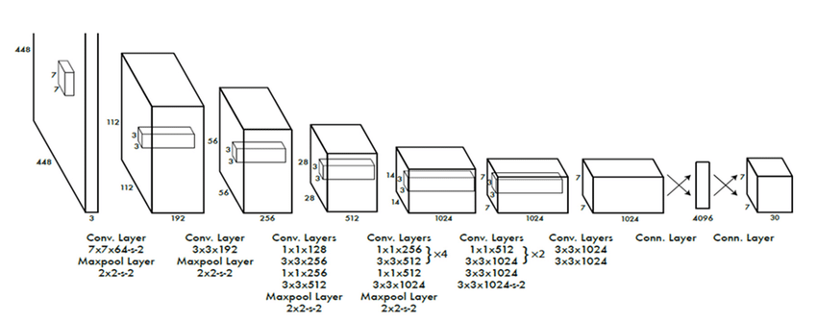
How Does Deep Learning Help?
channels
Semantic info is fed into FCN for NN to associate the information and tune its weights and biases accordingly to detect and classify objects
Original YOLO Architecture
Dimensions
Image is processed through multiple convolutional and max pooling layers to extract semantic information about the image
Notes:
In deep learning the image is processed through multiple convolutional filters and max pooling to extract semantic information about the image such as the edges and texture on top of the colours.
This is then fed to the fully connected layers for the neural network to associate and understand the different classes; and tune its weights and biases to detect and classify objects accurately

Slide 11
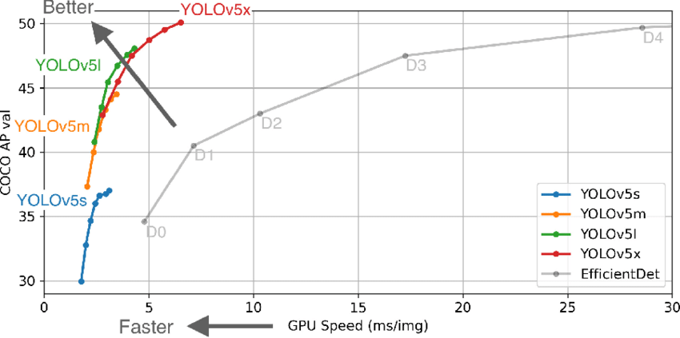
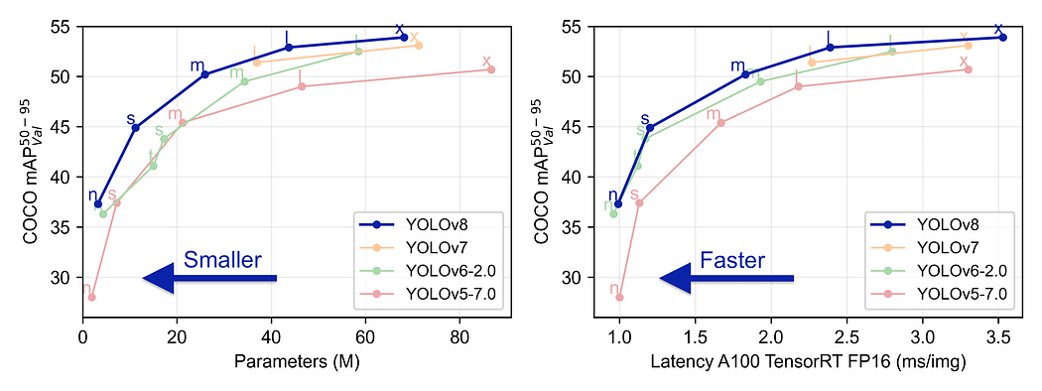
YOLO - Performance Comparison
Model Used
YOLOV5m for Comparison
Notes:
This slide shows the performance of yolo. Since most of you guys are familiar with efficientdet, the graph on the left shows how yolov5 compares to yolov5 and the graph right shows how yolov8 compares to yolo5.
I used yolov8s to for my capstone project. In the next few slides I will briefly go through with how yolov8 works. I will mainly touch on YOLOv8 main features such as anchorless detection and single stage detection before showing you the overview of yolov8’s architecture.

Slide 12
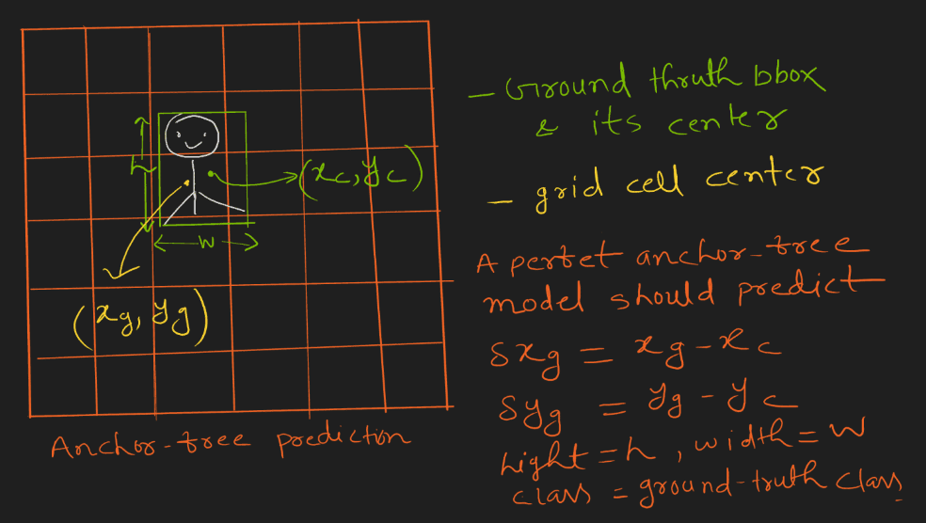
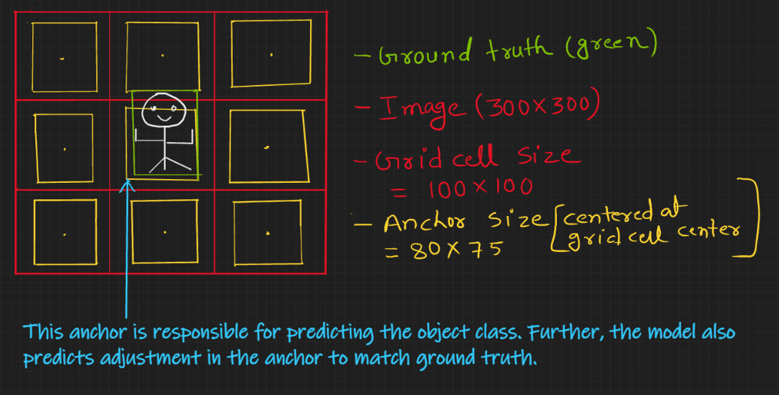
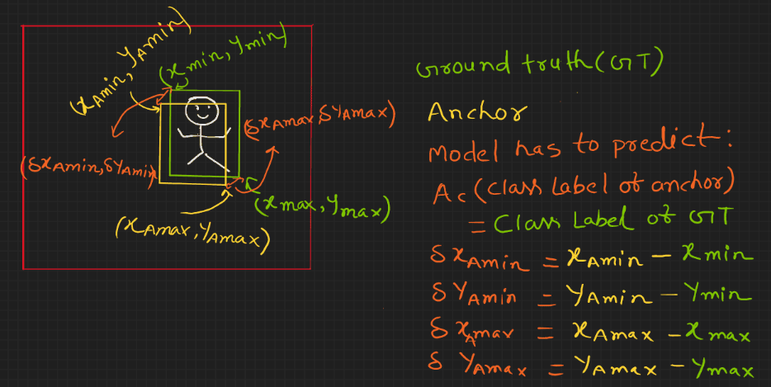
YOLO – Anchorless Detection
Anchorless Detection
Anchorless Detection
One point in each grid cell
Loss is Calculated based on the center point, width and height
Anchor Based Detection
One Anchor box in each grid cell
Loss is calculated based on diagonal coordinates of the of the anchor boxes
Advantages & Disadvantages
Anchorless based detection are more generalizable for key point detection , but Anchor based object detection is limited to bounding box prediction
More anchors result in better accuracy but it is also more computationally expensive and slower
Anchor base Detection
Notes:
So the main difference between anchor base detection and anchorless detection is that, the anchorless section has one point in each cell to detect the centre of an object., whereas the anchor base detection has an anchor box in each cell to detect the object as instead.
In the anchorless detection, once an object is detected, it will try to localise the object by determining the width and height of the object.
In an anchor base object detection, the object is localized by fitting the anchor box to the bounding box.
The anchorless object detection is more generalizable since it tries to size the object via the weight and height. However the anchor based detection can’t do this, so it is only limited to predicting the bounding boxes. In general the anchor based detection is more accurate but it is also more computationally expensive, and since it require more resources to compute it is slower.
In the next slides wool will see how the anchorless detections is used in yolo

Slide 13
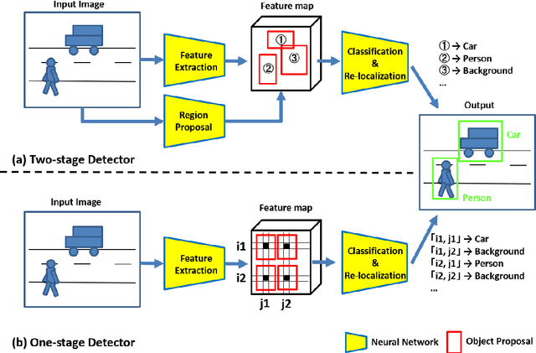
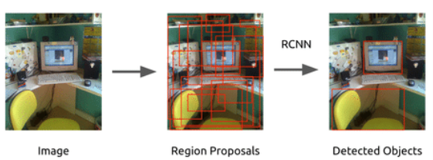
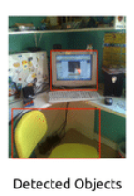
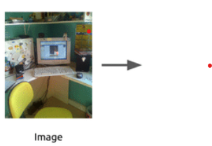
YOLO – Single Stage Detector
2-Stage Detector
1-Stage Detector
Notes:
So YOLO is a single stage detector. Both the 1 stage and 2 stage detectors will require image features to be extracted first. This done is through a series of convolutional network and pooling. After having done this:
The 2-stage detector uses a region proposal network to output bounding boxes, usually up to about 2000 bounding boxes in the image .
Then the anchor boxes that coincides with these bounding boxes will help determine if any objects are detected within its anchor region.
If an object is detected, it will adjust the anchor, to fit the objects
After this is done it will proceed to classify the object and further adjust the bounding box coordinates to fit the object
The red dotted box shows how this will look like in a real image.
In 1-stage detector, the image is split into a n x n gird.
Each grid is responsible to detect whether an object is present in the grid and what class does this object belong to.
I will explain more of this in the next slide, but notice how the 1 stage detector can directly detect the images without the need for region proposal.

Slide 14
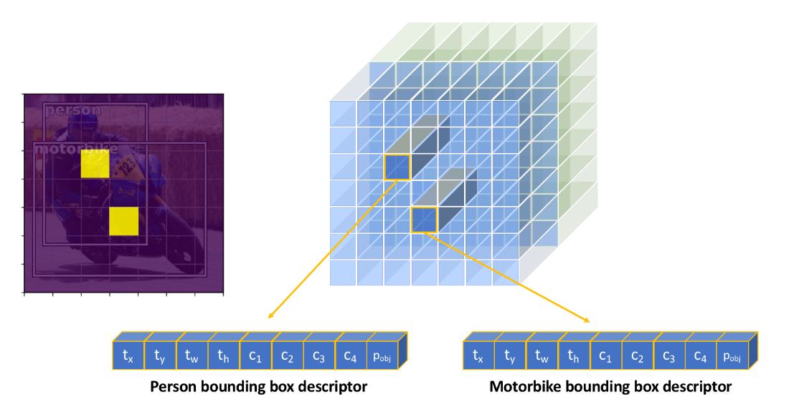
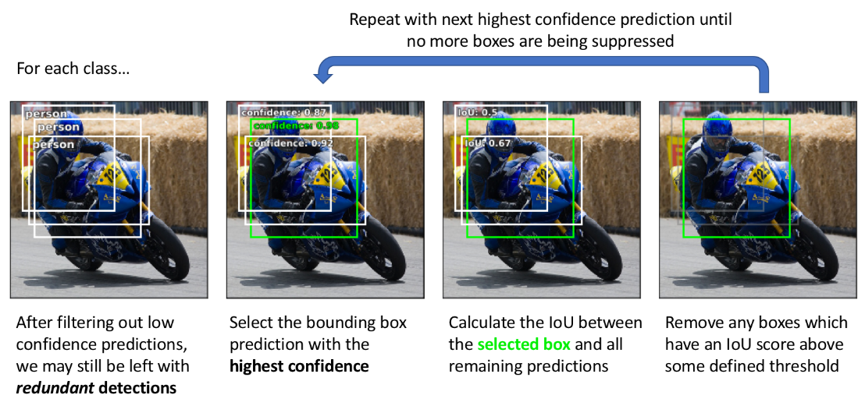
YOLO – Detection & Non-Max Suppression
Single Stage detector with anchorless detection
Non-Maximum Suppression
Notes:
Single Stage detector with anchorless detection
So this slide shows how a single stage detector works with anchorless detection. The bike image that you see, is split into a 7 x 7 grid.
After the extraction of the feature maps, If the cell detects the CenterPoint of an object. The x and y coordinates of the centre point, width and height and class information that you see here.
If no objects are detected then, the array will be filled with zeros. An array of zeros are considered background.
Non Max Suppression
After the objects are detected, multiple bounding boxes are proposed to localise the object. These bounding boxes are filtered out using confidence thresholds.
The IOU is calculated for the remaining boxes.
The remaining boxes with IOU beyond a certain thresholds are removed to prevent predicting the same objects.
This process is known known as Non-Max Suppression

Slide 15
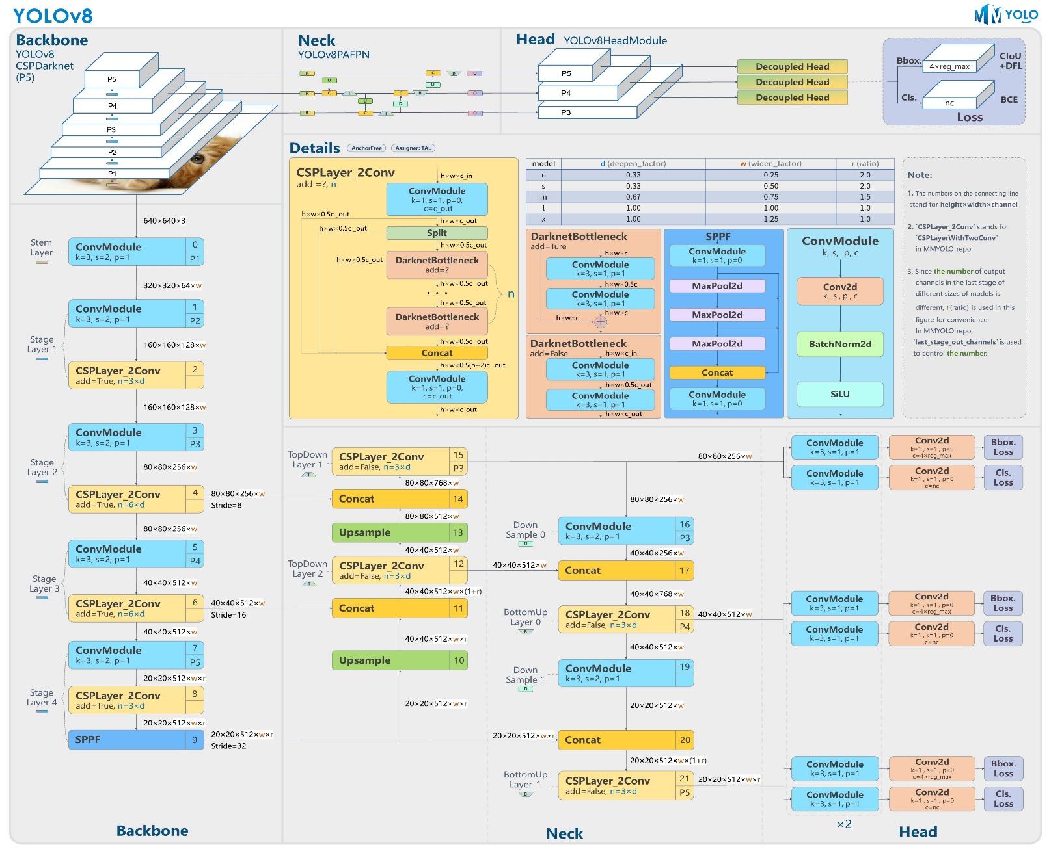
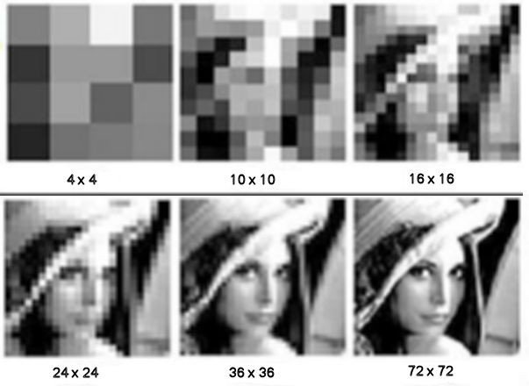
YOLO – Overview of Architecture
High resolution has more accurate spatial information
More semantic information
is extracted in bottom layers but resolution is reduced
Unsampled and concatenated to combine the semantic and spatial info
Notes:
The is the overview of the yolo architecture. The diagram can be a little overwhelming, but if you look closely it is just a series of convolutional layers and carpooling to extract image features for detection and classification.
The architecture can be categorised into three broad categories. The first is the backbone. This is where the image is fed as an input and the features are extracted through a feature pyramid network. In the feature pyramid network, more semantic information such as the colour, edges and texture is extracted at the bottom layers since there are more channels. However this comes with a loss of spatial information since the image resolution is decreases with increases layer.
In order to compensate for this, the neck region upsamples the output from the bottom layers and concatenates the information with the higher layers. So now the feature maps will have both spatial and semantic information for detection. In this case upsampling means transforming the lower resolution image to the same resolution that the higher layers. The information is concatenated along the channel axis.
Once the information is extracted and further processes in the neck region, it is parsed to head region for detection and classification. The detection, like what I explained in the previous few slides occurs at each grid cell using the features maps. There are three detect regions here to detect small, medium and large objects.

Slide 16
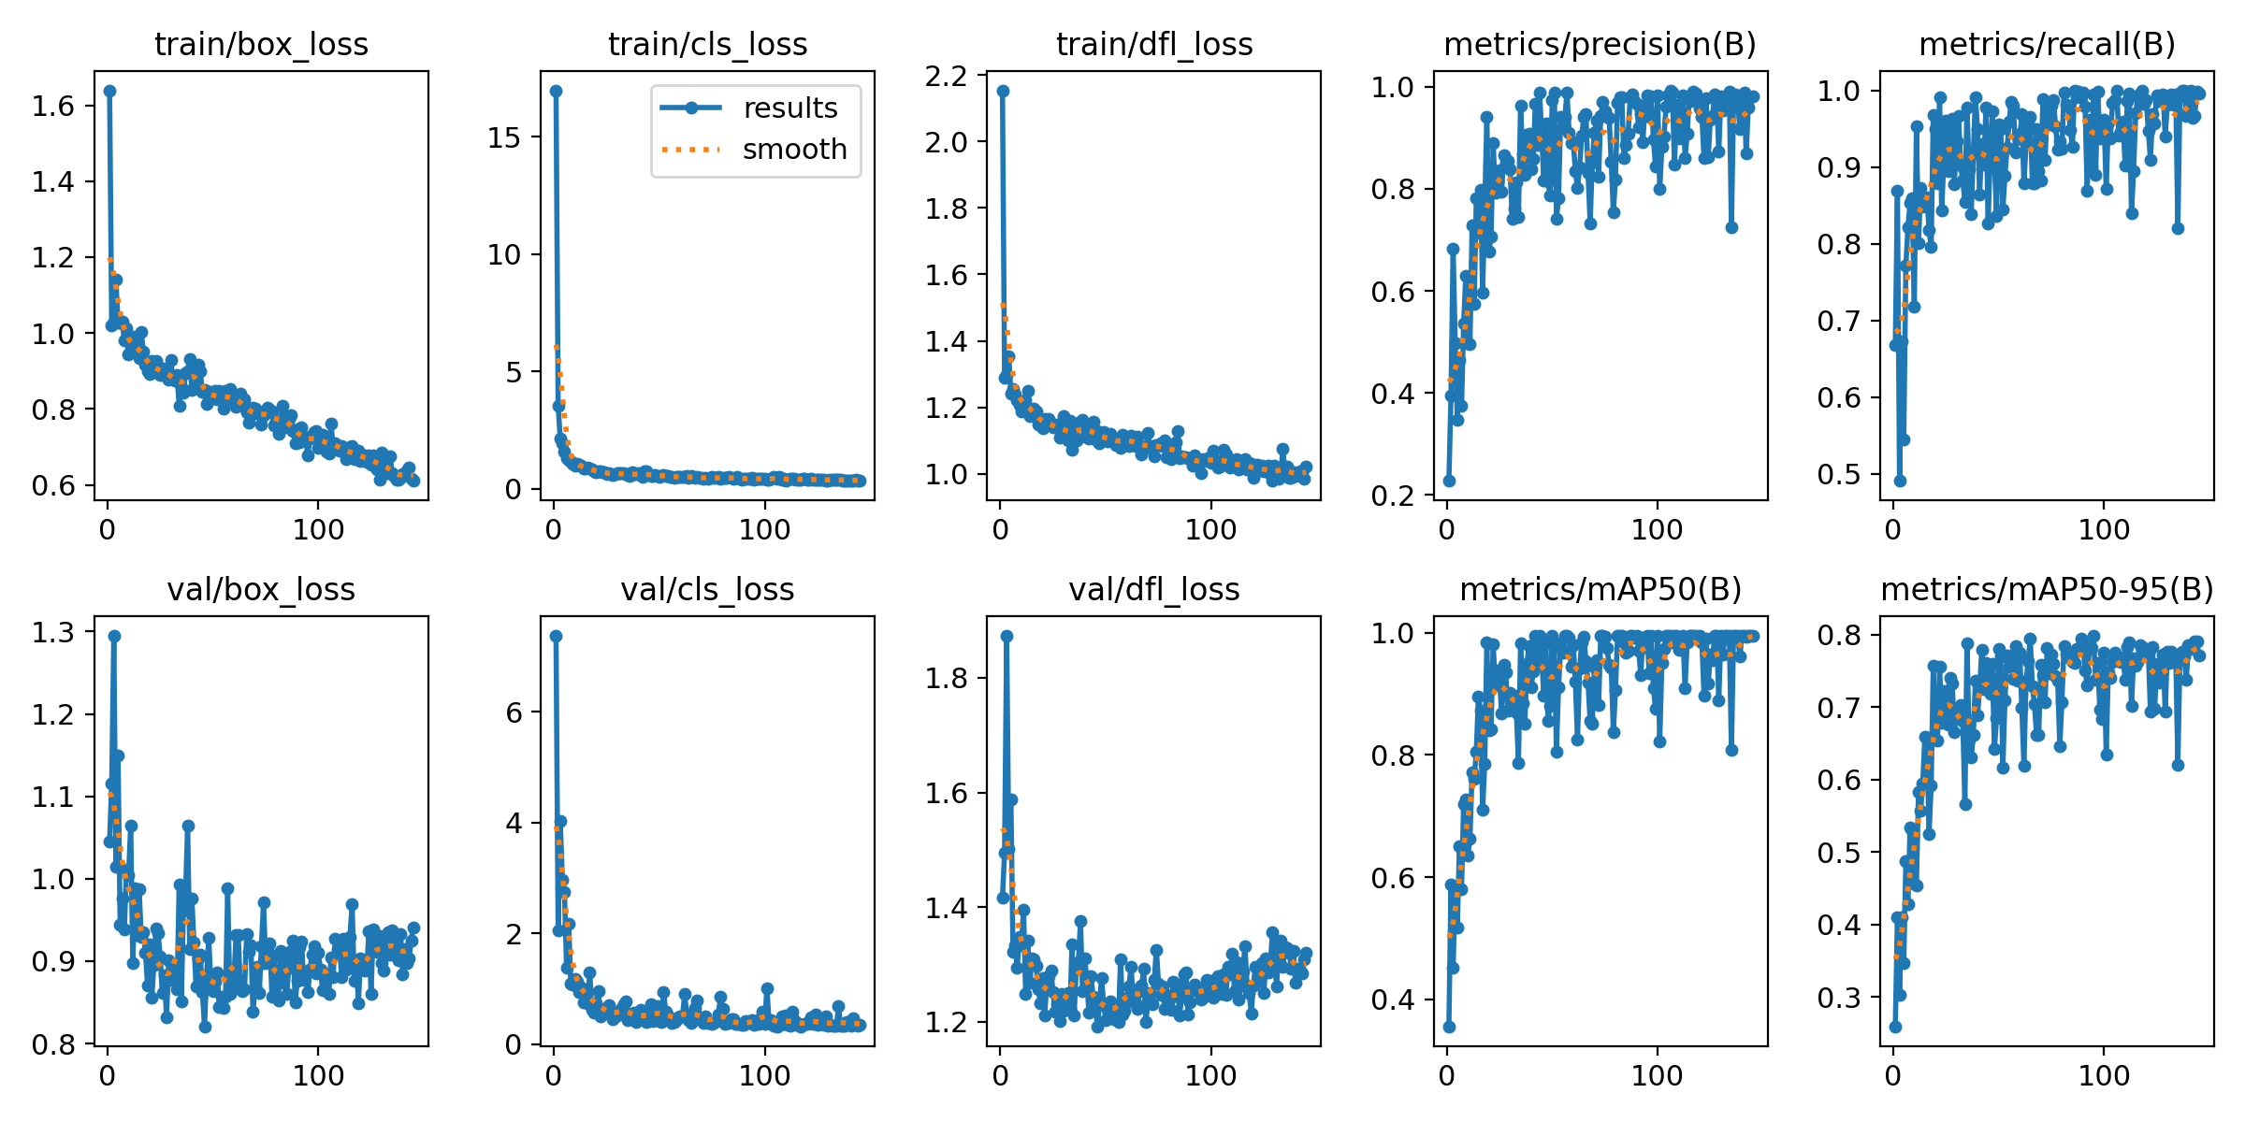
Overall Results
Notes:
These are the models overall results. I will go into greater detail in the next few slides.

Slide 17
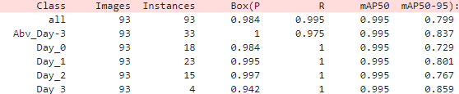
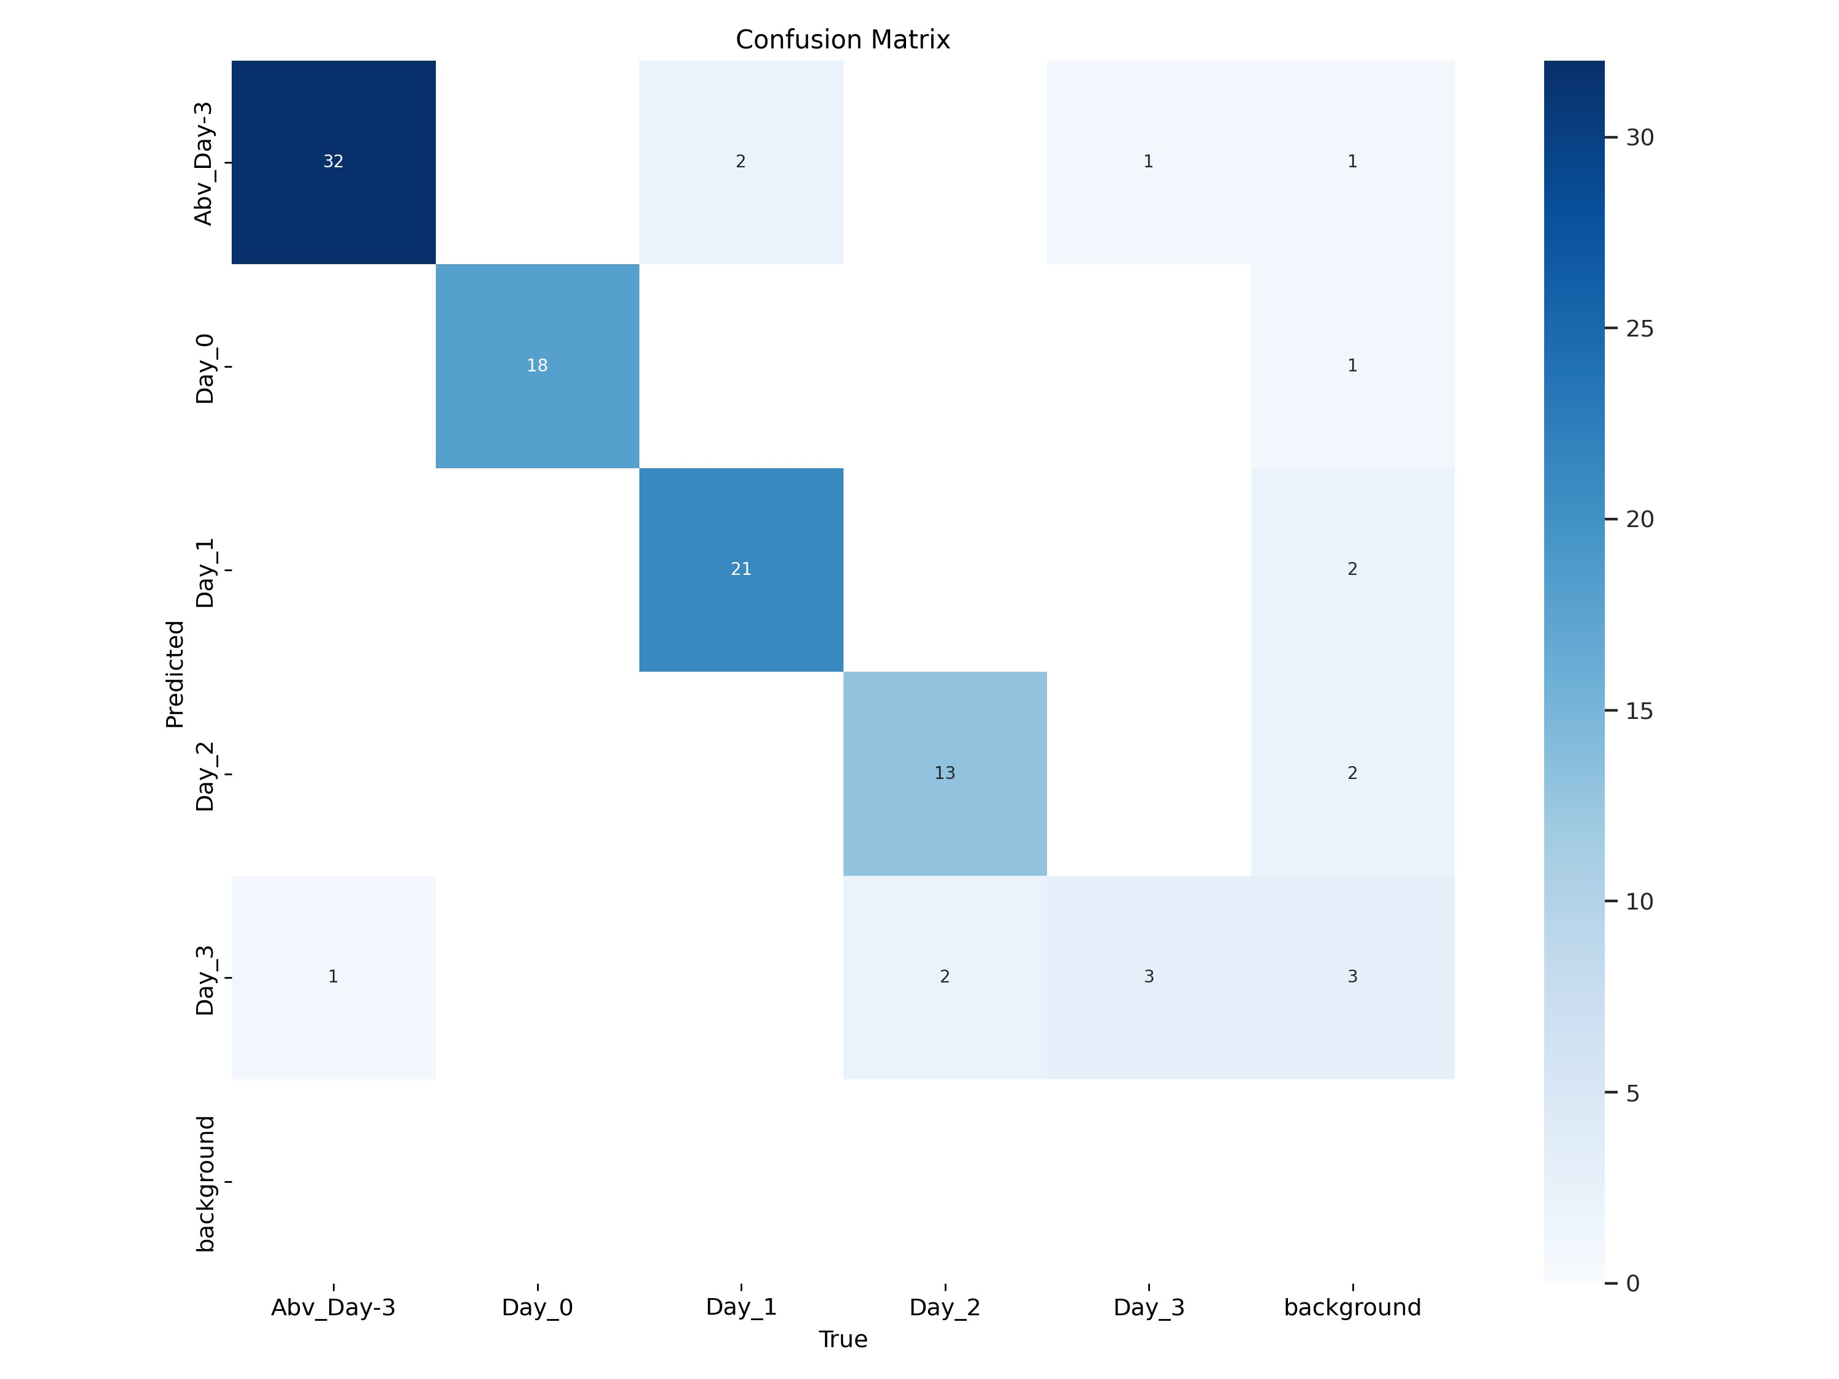
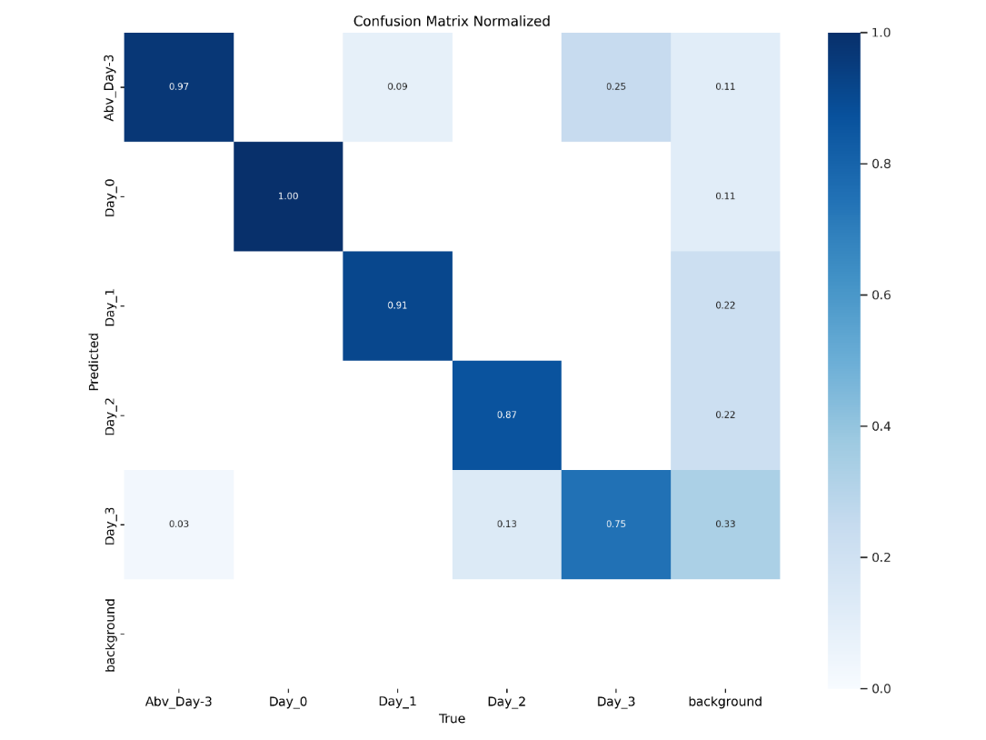
Model’s Val Scores & Confusion Matrix
Notes:
Model is generating an MAP of 0.995 and an accuracy of 85% based on the confusion matrix.
87 accurate predictions out of 102 predictions

Slide 18
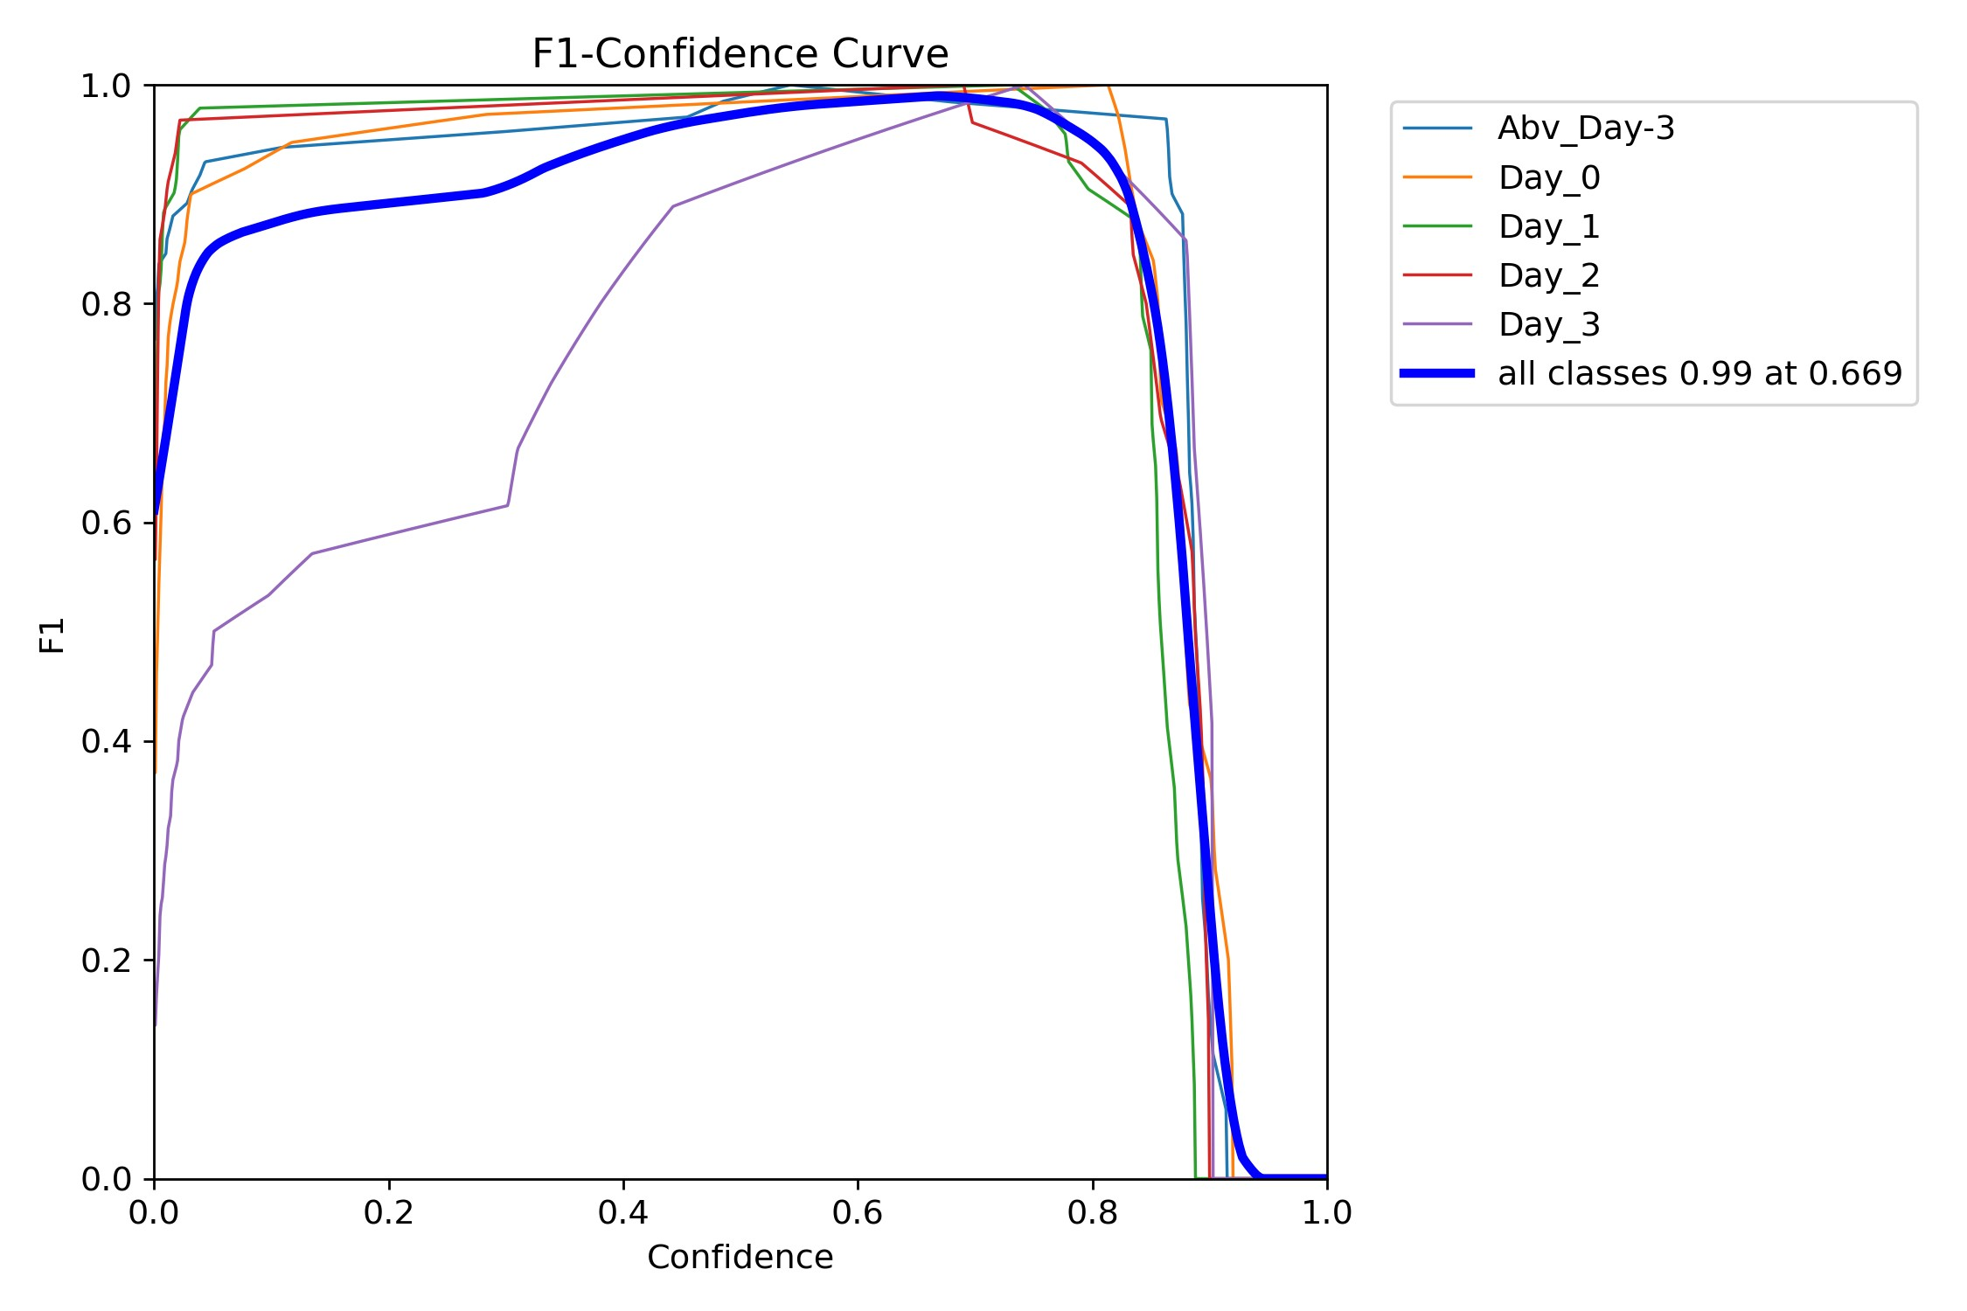
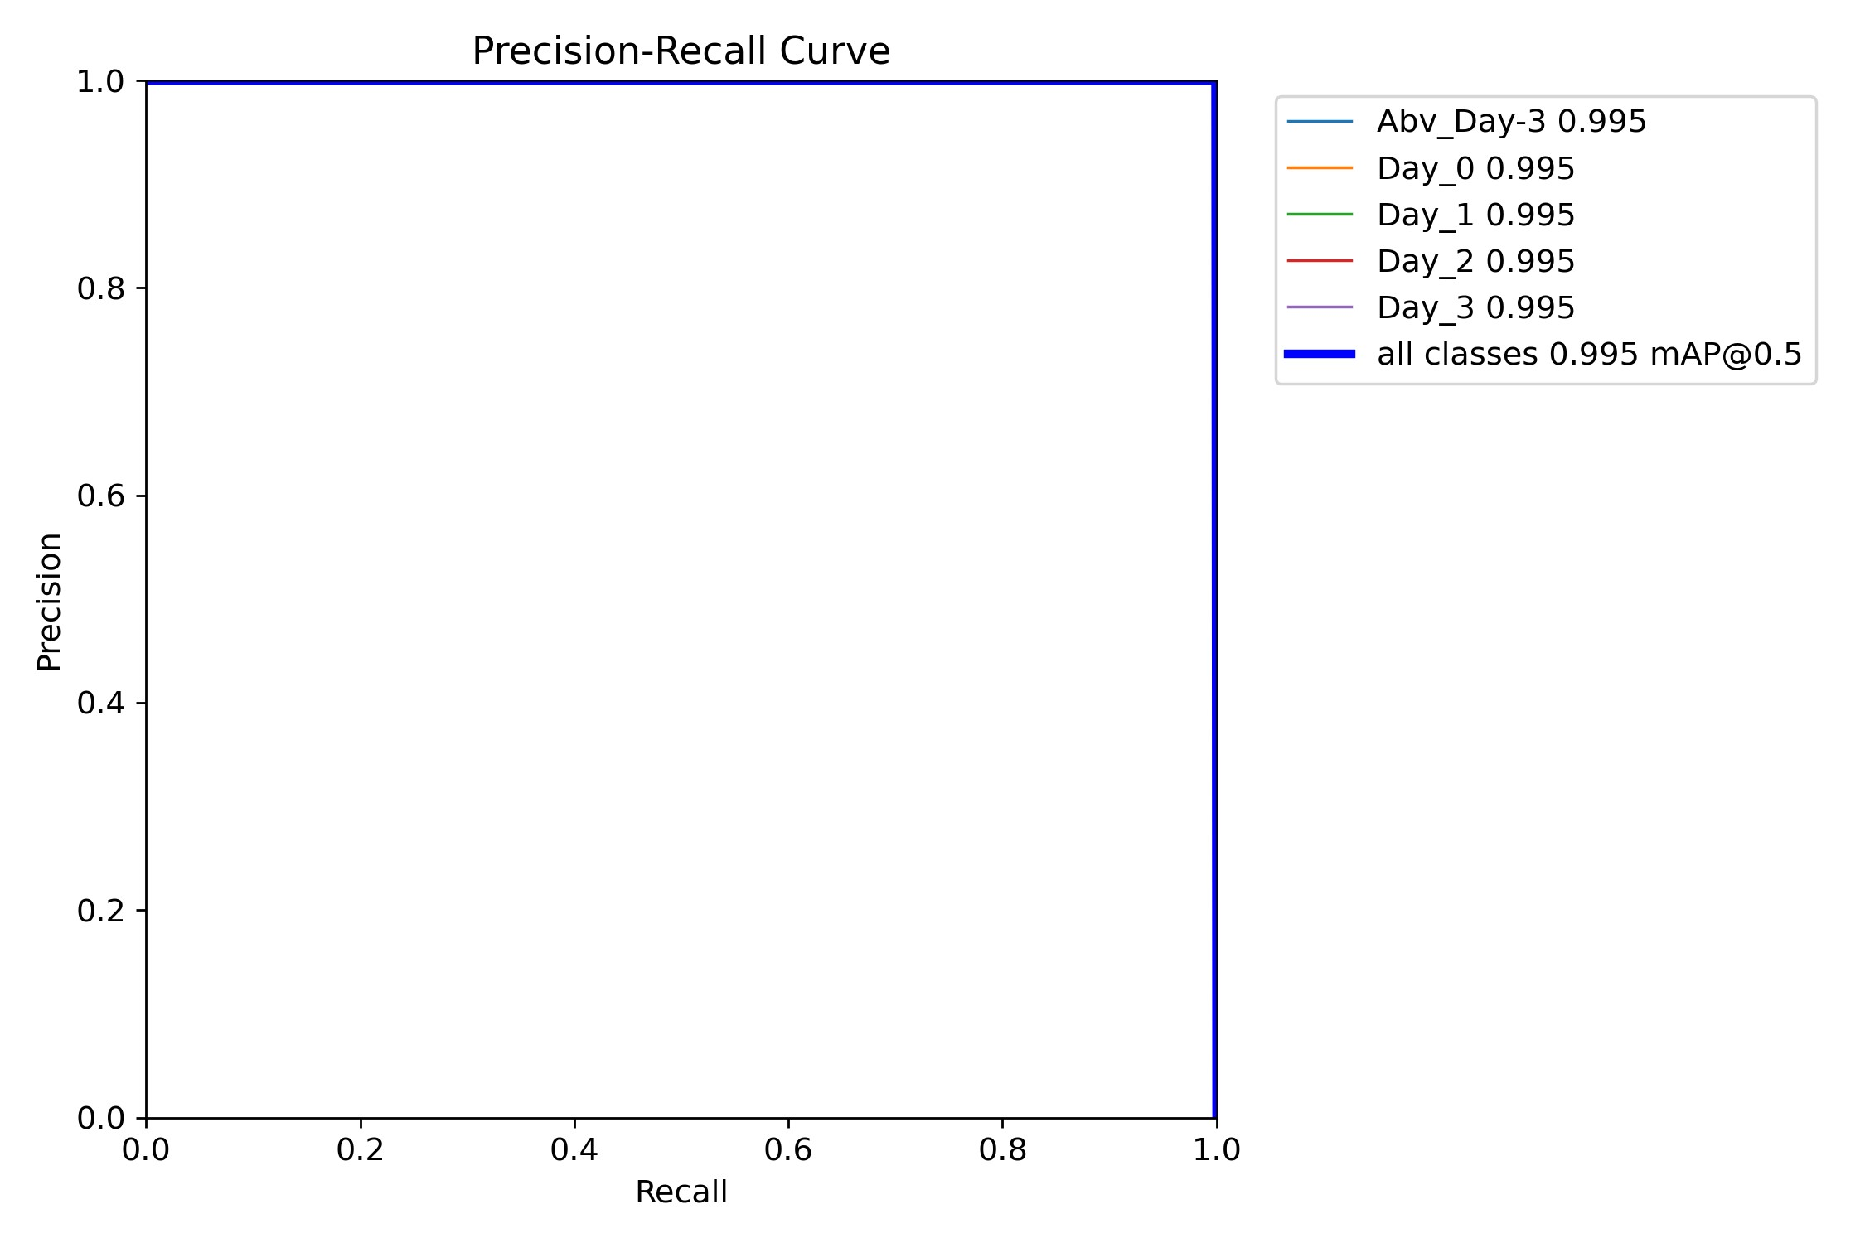
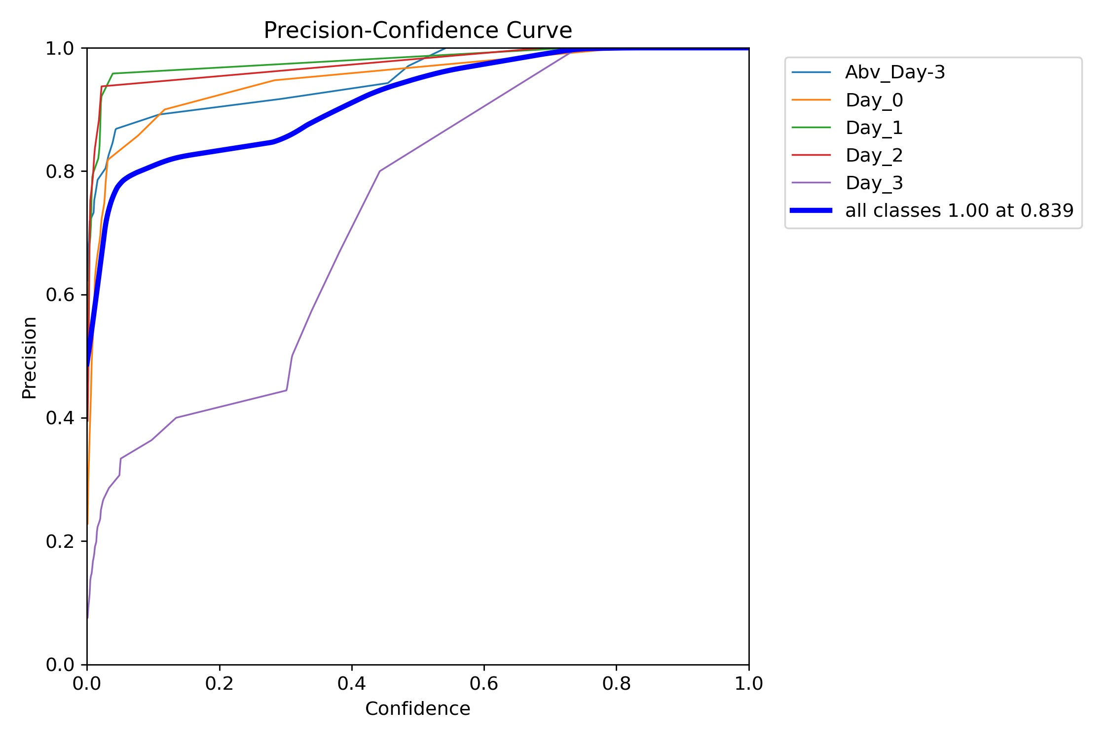
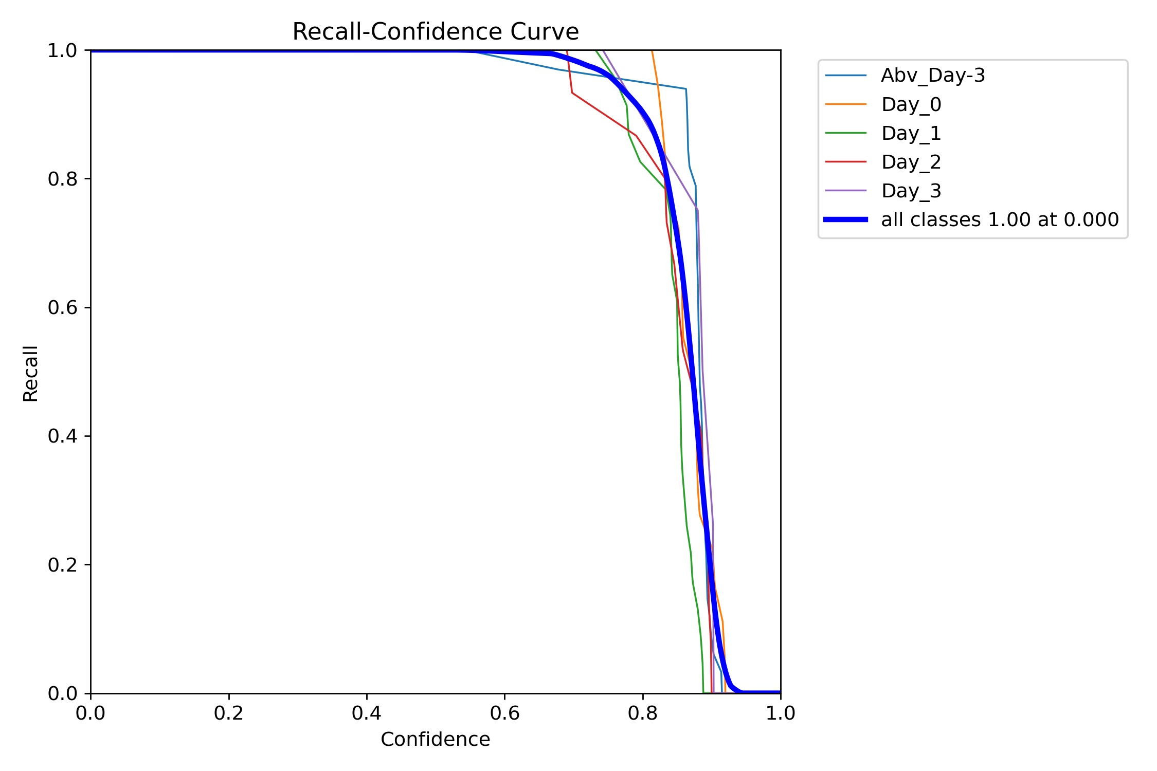
Model’s Results – F1, Precision & Recall
Reflects balance
Between precision & Recall
Reflects MAP
Precision minimizes false detection
Recall detects every instance of the object
Notes:
These are the models results.
The model has a near perfect F1 score at 67% confidence
The model has an mean average precession of 0.995 and 50% IOU
The model is
Precision measures how well you can find true positives(TP) out of all positive predictions. (TP+FP).
Recall measures how well you can find true positives(TP) out of all predictions(TP+FN).
The mAP is calculated by finding Average Precision(AP) for each class and then average over a number of classes.
mAP encapsulates the tradeoff between precision and recall and maximizes the effect of both metrics.
Precision curve is upsloping because as confidence increases model becomes more precise
Recall curve is down sloping because as confidence increases there are lesser detections

Slide 19
Demo – Sheng Siong
Notes:
This is a demo from Sheng Siong

Slide 20
Recap on Future Work
Recap on Use Cases:
Model could be hosted on handheld devices to empower consumers
Businesses both online and offline, can gain a competitive advantage incorporating the model in their premises to help customers select their fish more confidently
Future work
Model can be upscaled to a larger variety of fish
Could explore using alternate imagining devices, such as hyperspectral imaging to make model more robust, or expand the use cases to fruits and vegetables

Slide 21
References
https://www.statista.com/outlook/cmo/food/fish-seafood/singapore
https://www.straitstimes.com/tech/wet-market-seafood-delivered-to-your-doorstep-thankfully-fres
https://learnopencv.com/centernet-anchor-free-object-detection-explained/
https://www.jeremyjordan.me/object-detection-one-stage/
https://www.researchgate.net/figure/Two-stage-vs-Proposed-a-The-two-stage-approach-separates-the-detection-and-pose_fig1_308320592
https://medium.com/@freshtechyy/fusing-backbone-features-using-feature-pyramid-network-fpn-c652aa6a264b
https://docs.ultralytics.com/guides/yolo-performance-metrics/#visual-outputs

Slide 22

THANK YOU

